Slide 1


Helmet Guard: Ensuring Safety Through Detection
Helmet detection technology offers a promising solution to improve road safety by addressing the challenge of helmet compliance among motorcyclists.

Slide 2

The Importance of Helmet Usage
1
Head Protection
2
Reduced Fatalities
Helmets serve as a vital safety barrier, mitigating head injuries during accidents.
Studies have shown a significant reduction in motorcycle-related fatalities with consistent helmet use.
3
Brain Injury Prevention
4
Legal Compliance
Helmets provide crucial protection against traumatic brain injuries, minimizing the risk of long-term consequences.
Wearing helmets is often mandatory by law, ensuring a safer and more controlled road environment.

Slide 3
Limitations of Manual Enforcement
Subjectivity
Resource Constraints
Efficiency Challenges
Manual enforcement can be subjective and prone to bias, leading to inconsistent application of the law.
Limited manpower and resources can hinder the ability to effectively monitor all vehicles and enforce helmet compliance.
Manual enforcement is time-consuming and often inefficient, requiring significant effort to identify violations.

Slide 4

Computer Vision for Automated Helmet Detection
Image Recognition
Real-time Monitoring
Computer vision algorithms can automatically detect the presence or absence of a helmet by analyzing images or video feeds.
Helmet detection systems can operate in real-time, providing continuous monitoring and immediate alerts for violations.
Data Analytics
Objective Enforcement
The collected data can be used to analyze helmet compliance trends, identify hotspots, and optimize enforcement strategies.
Automated helmet detection eliminates human bias, ensuring fair and objective enforcement of regulations.

Slide 5
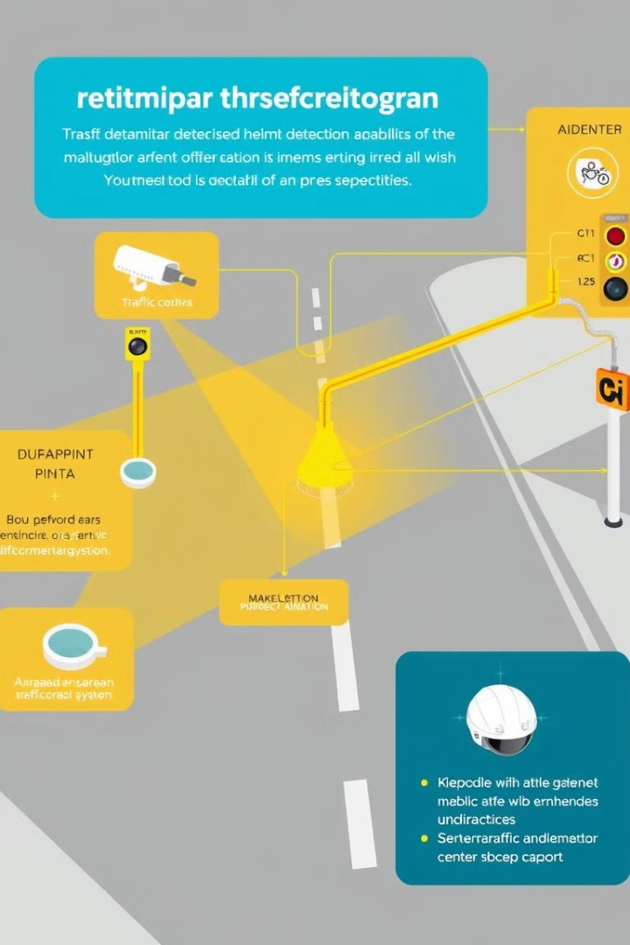




Integrating Helmet Detection into Traffic Management Systems
Traffic Cameras
Helmet detection algorithms can be integrated with existing traffic camera networks to capture real-time footage.
Automatic Detection
The system analyzes video streams to identify vehicles and automatically detect the presence or absence of helmets.
Alerts and Notifications
Real-time alerts can be triggered for helmet violations, allowing authorities to take appropriate action.
Data Analysis
The collected data can be analyzed to assess helmet compliance trends and identify areas for improvement.

Slide 6
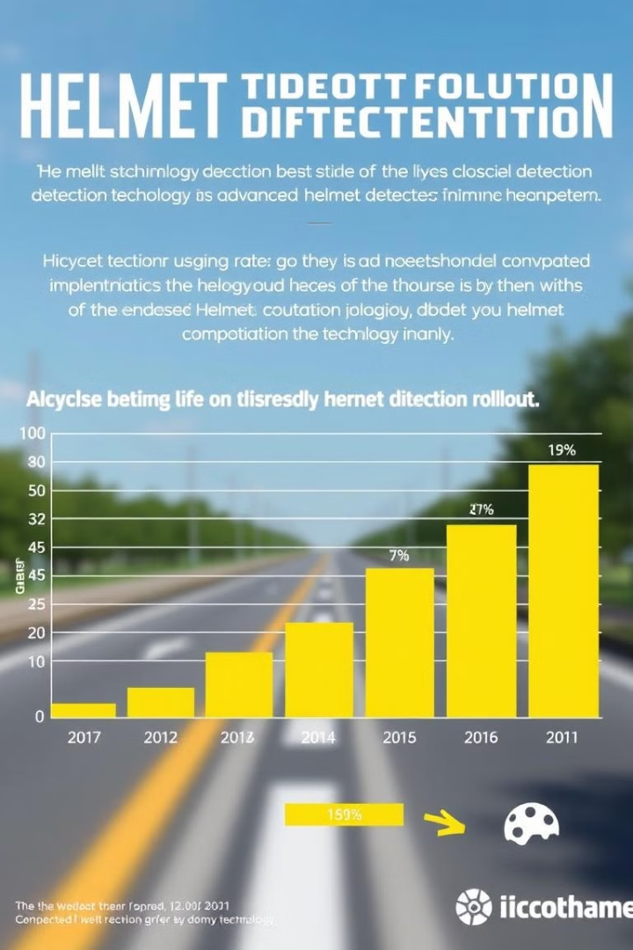
Improving Helmet Compliance Rates
Factor
Impact on Compliance
Increased Visibility
Motorcyclists become aware of the automated system and are more likely to comply.
Reduced Subjectivity
Automated enforcement eliminates bias and promotes fairness, encouraging compliance.
Data-Driven Enforcement
Data analysis enables targeted enforcement efforts, optimizing resources and maximizing impact.
Deterrent Effect
The possibility of automatic detection and enforcement serves as a strong deterrent to non-compliance.

Slide 7





Enhancing Road Safety through Technological Solutions
Reduced Accidents
Fewer Fatalities
Improved helmet compliance leads to fewer accidents and injuries, improving overall road safety.
The reduction in head injuries caused by helmet use significantly decreases the number of fatalities.
Improved Quality of Life
Healthier Communities
Safer roads lead to a better quality of life for everyone, fostering a sense of security and peace of mind.
Reduced accidents and injuries contribute to a healthier and more vibrant community, promoting well-being.

Slide 8

Conclusion and Next Steps
Helmet detection technology presents a powerful tool for promoting road safety by enhancing helmet compliance. Further advancements in computer vision, integration with traffic management systems, and public awareness initiatives can further improve the effectiveness of this innovative solution.

